Slide 1
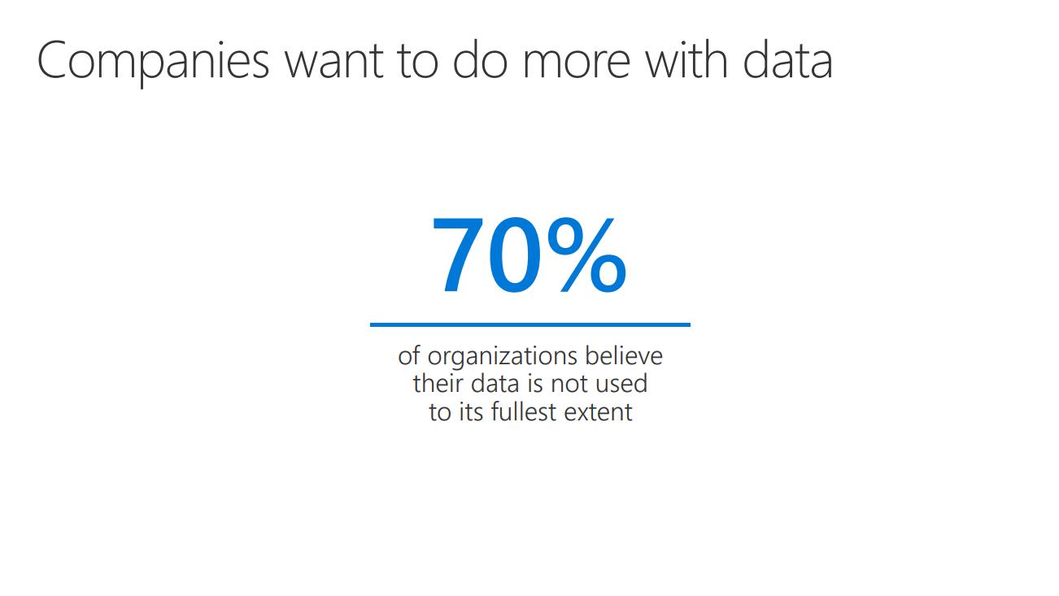

Slide 2
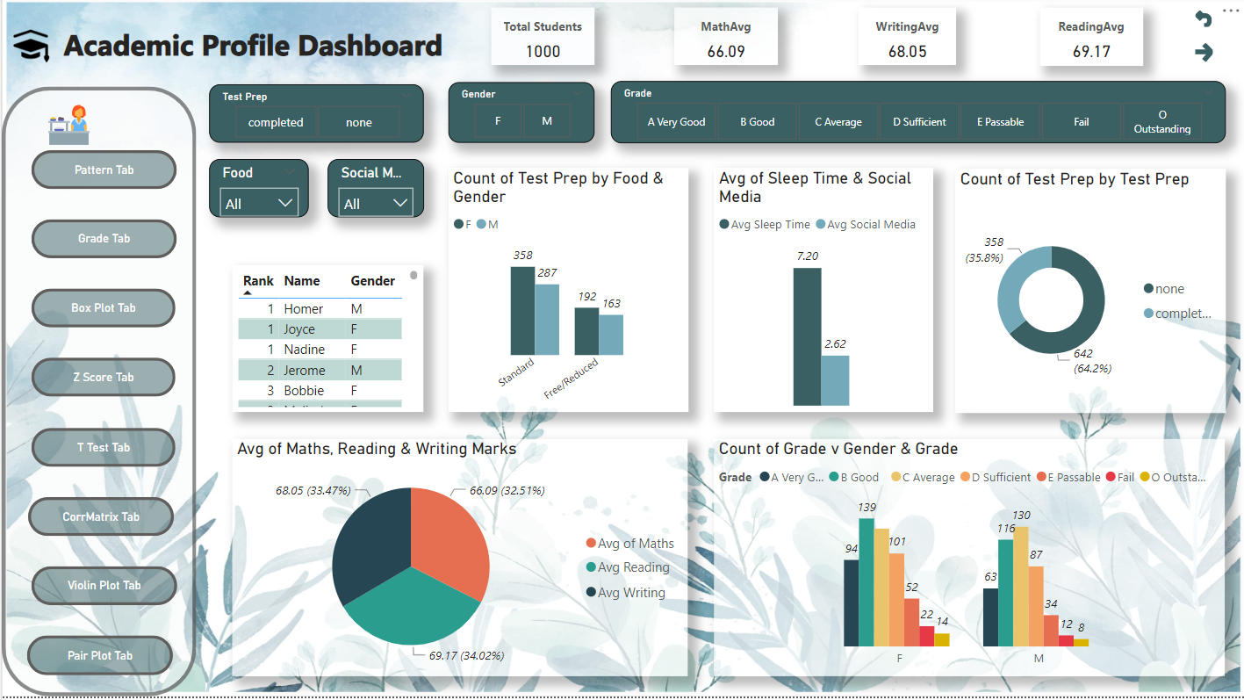
Task 1 -Connecting data source and cleaning data
Importing Dataset and Establishing Connections in Power BI
Establishing Relationships
Table Relationship Formation: Creating associations between tables using ID Numbers and Names for enhanced data analysis.
Column Creation: Total Marks, Grade, Rank, Percentage
Column Establishment: Total Marks, Grade(based on given grading system), Rank, and Percentage columns formulated for comprehensive assessment.
New Measures Introduced
Average Total Marks: Providing an overview of academic performance.
Subject-Specific Averages (Reading, Writing, Math): Identifying strengths and areas for improvement.
Average Sleep Time & Social Media Time: Analyzing their impact on student performance.

Slide 3
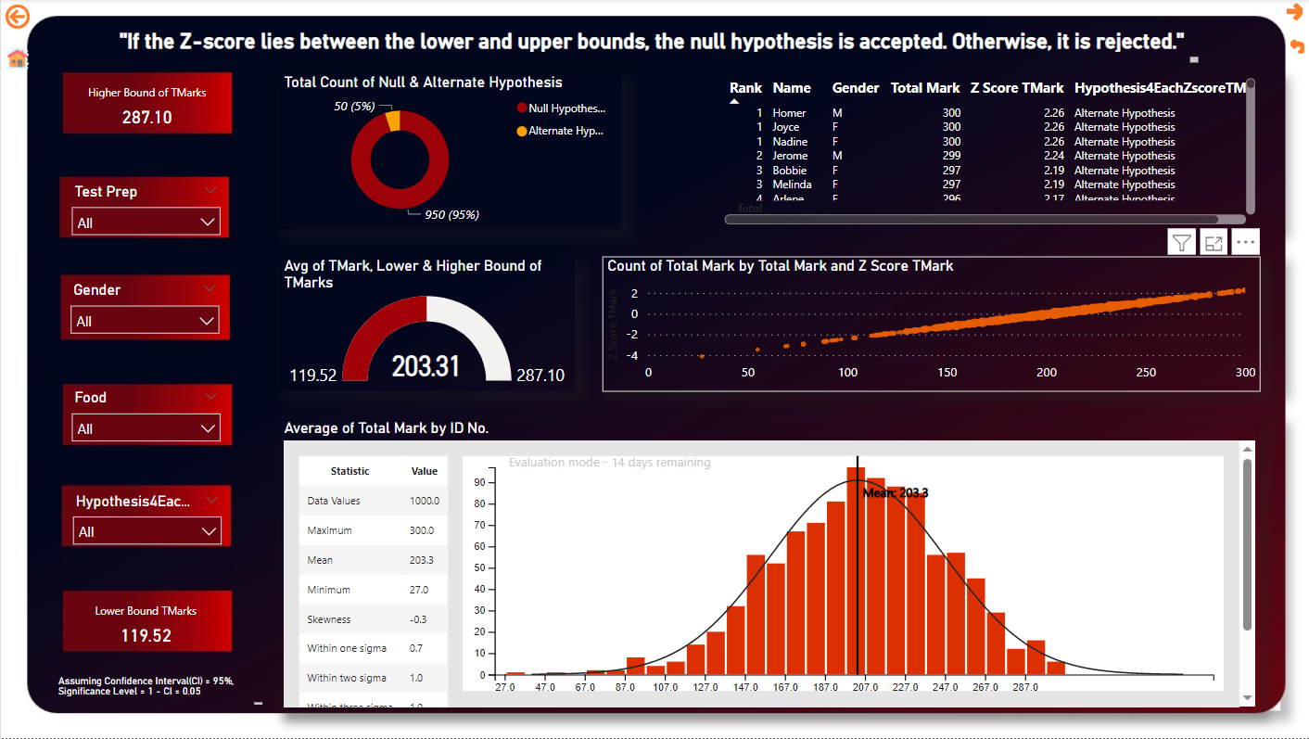
Task 2-Advanced Exploratory Data Analysis in Power BI
Hypothesis Testing Using Two-sample T-tests
Procedure: Created a dataset sample for conducting two-sample T-tests on sleep time and test preparation.
Complex Analysis: Integrated T-distribution table into the dataset for comprehensive statistical evaluations.
Null Hypothesis: Assumed no significant difference in mean sleep time between students who completed test preparation and those who didn’t.
Findings: Accepted the null hypothesis
Correlation Analysis for Interdependencies
Approach: Utilized PyScript analysis to explore variable interdependencies.
Conclusion: Identified that Academic Performance is linked with parental education, food intake, and test preparation. And very weak correlation with categorical variables.
Z-Score Calculation for Total Marks
Objective: Deriving Z-scores for individual total marks to establish lower and upper bounds for inclusion/exclusion criteria.
Purpose: Assessing whether the sample dataset conforms to a bell curve distribution. Also want to find the higher and lower bound of total marks.

Slide 4
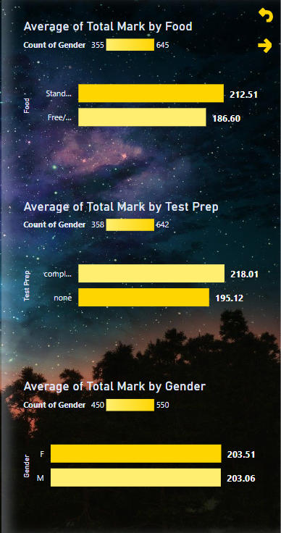
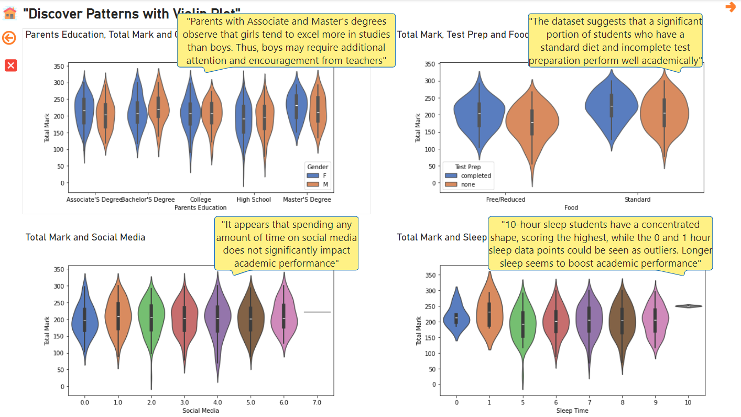
Task 3 -Comprehensive Data Analysis Report

Slide 5
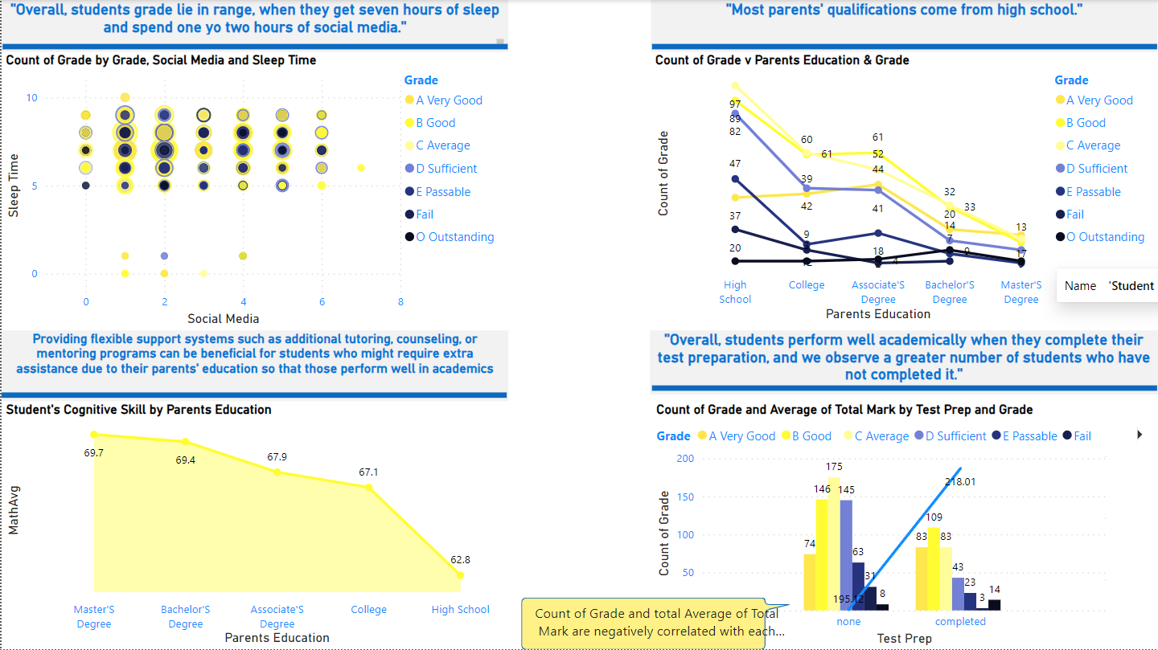
Task 4 -Final Presentation and Storytelling

